Slide 1
HOLIDAY CUSTOMS AND RULES OF POLITE BEHAVIOUR IN CHINA
Charu Arora
Gaurav Gaikwad

Slide 2
INTRODUCTION
China is the fourth largest country in the world.
Population is more than 1.3 billion.
World’s largest apple, rice and pork producer and consumer.
By 2025, China will build enough skyscrapers to fill TEN New York - sized cities.
The August 2010 traffic jam near Beijing was over 100km long and lasted for 11 days.
By 2025, China will pave up to 5 billion square meters of road.

Slide 3
HOLIDAY CUSTOMS
National Holidays: New Year's Day, Women's Day, May Day, Children's Day...
Traditional Festivals: Chinese New Year, Qingming, Dragon Boat, Mid-Autumn Day, Chongyang...
Ethnic Minority Festivals: Water-Splashing, March Fair, Nadam Fair, End of Ramadan, Corban...
Tourism Festivals: Harbin Ice & Snow Gala, Luoyang Peony Fair...
Western Festivals Celebrated in China: Christmas, Halloween, Valentine’s Day…

Slide 4
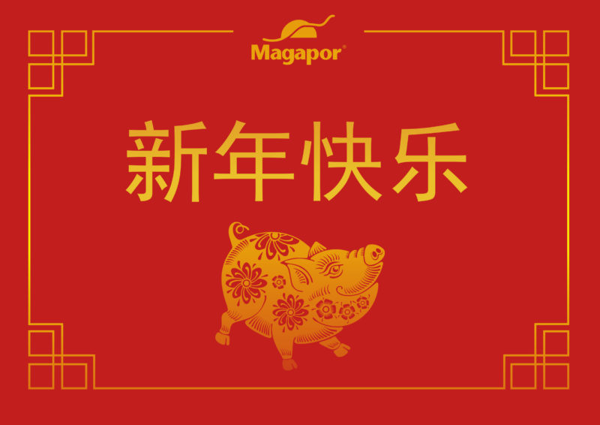
NATIONAL HOLIDAYS
1st January - New Year’s Day
New Year, traditional around the world and observed on the night of December 31 or January 1.
It is not so significant for the Chinese, as Chinese New Year or Qingming festival.

Slide 5
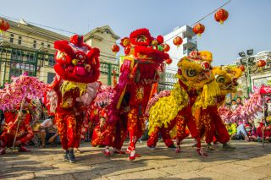
NATIONAL HOLIDAYS
January 28th - Chinese New Year
January 29th - Spring Festival
1st day in 1st lunar month, usually in Jan. or Feb.
The grandest traditional festival in China, the longest public holiday(7).
Annual family reunion, eat dumplings, set off fireworks.

Slide 6
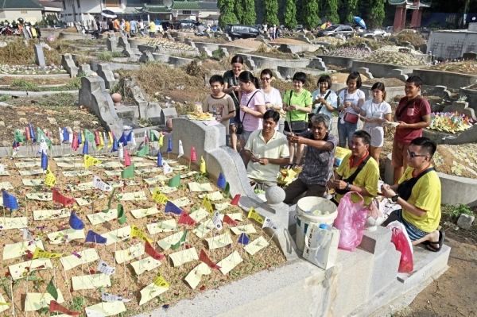
NATIONAL HOLIDAYS
April 5th - Qing Ming Jie holiday
Also known as Pure Brightness Festival or Tomb-sweeping Day.
Visit ancestors' tombs, spring outing.

Slide 7
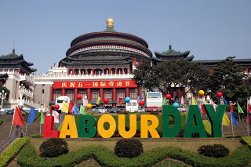
NATIONAL HOLIDAYS
May 1st – Labour Day
International Labour Day (May 1) is a three-day holiday in China.
People usually celebrate by going to scenic spots around the country, as well as spending sprees in shopping malls.

Slide 8
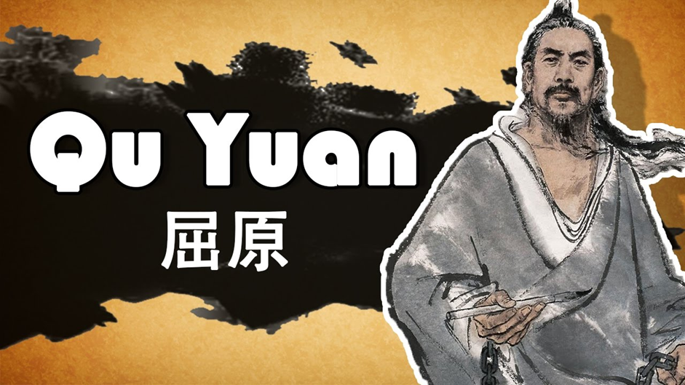
NATIONAL HOLIDAYS
May 28th – Dragon boat festival
To commemorate Qu Yuan (340-278 BC), an ancient Chinese patriotic poet.
Eat Zongzi.
Dragon boat race.

Slide 9
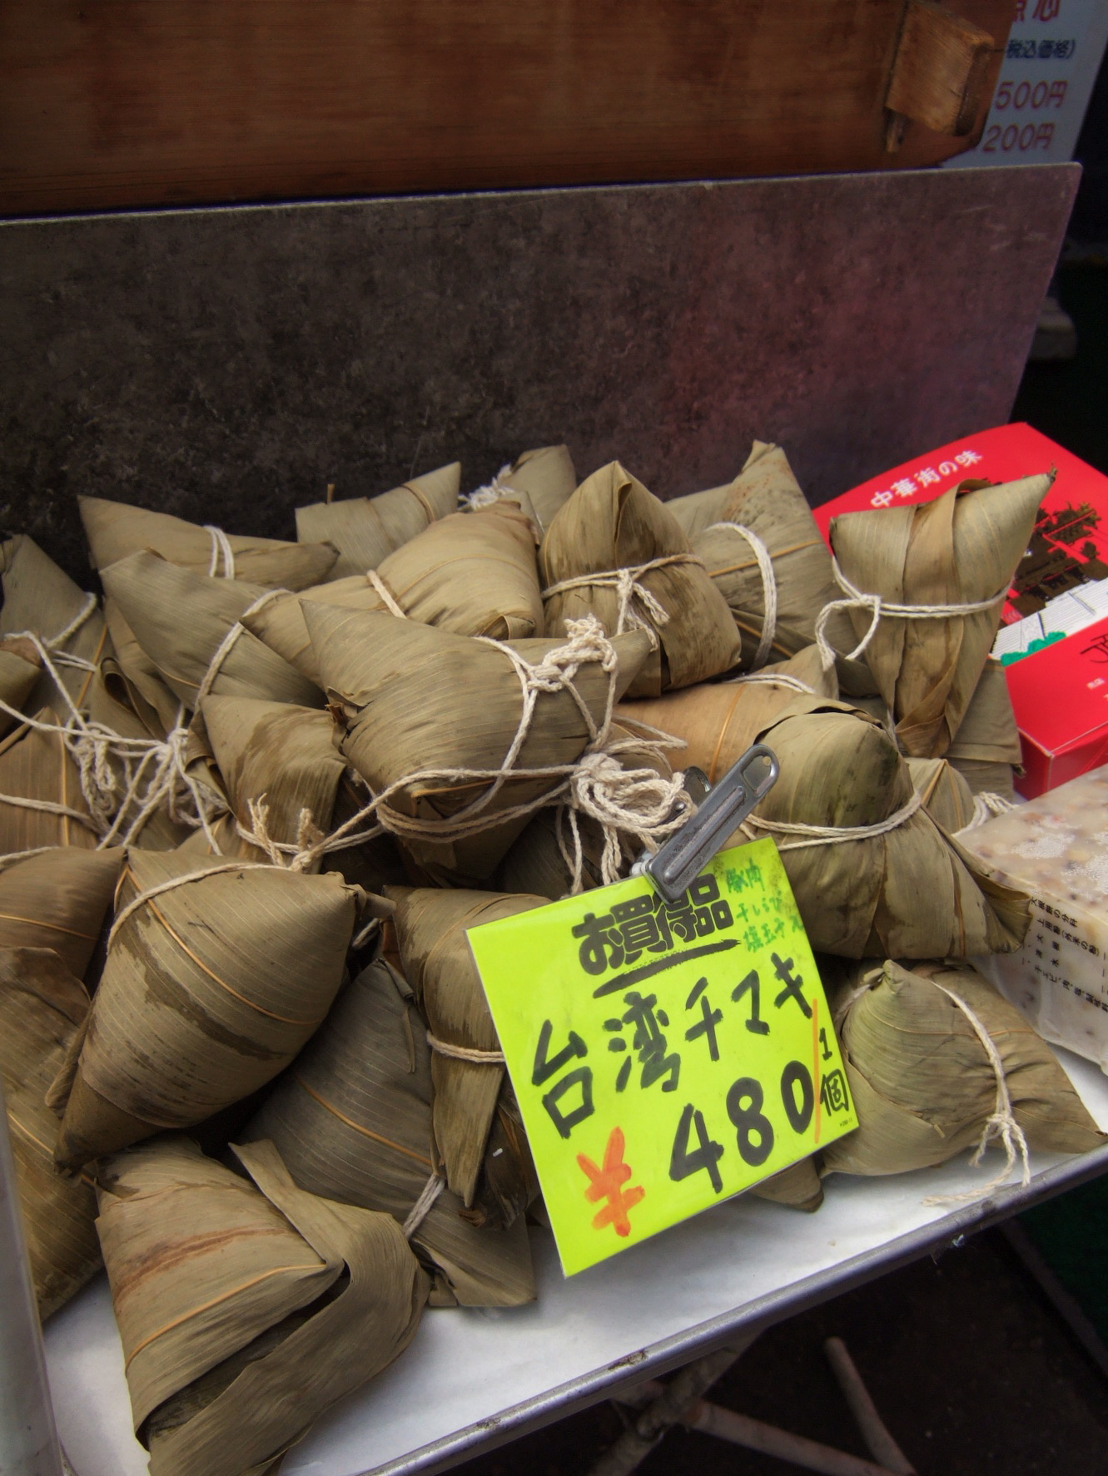
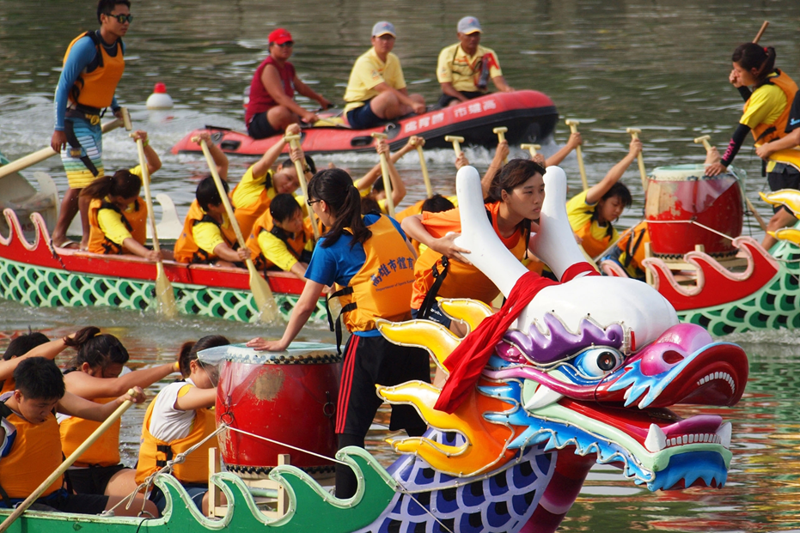
May 28th – Dragon boat festival

Slide 10
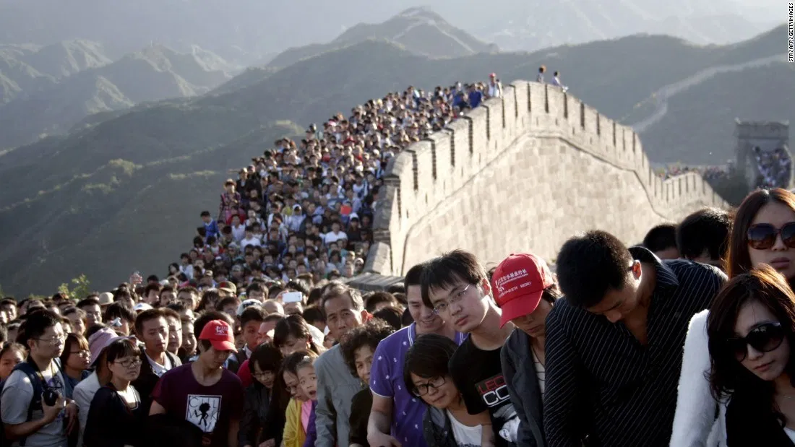
NATIONAL HOLIDAYS
October 1st – National Golden Week holiday
Military parade and celebration on the Tiananmen Square in Beijing.
Nationwide traveling peak from Oct. 1st to 7th regarded as the 'Golden Week'

Slide 11
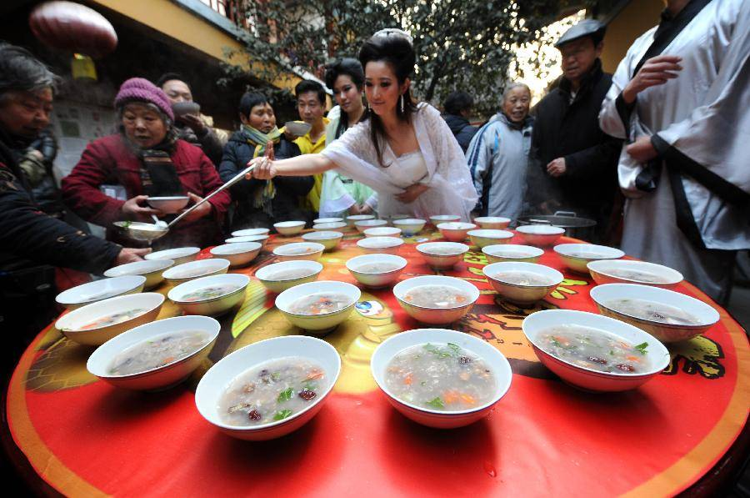
LOCAL HOLIDAYS
Laba: 8th day in 12th lunar month, usually in Jan.
Laba Festival was originally an occasion for people to give sacrifices to their ancestors, and to pray to heaven and earth for a good harvest and good luck for the family.
Many years later, it has become a Laba Congee eating event - a porridge that contains different types of rice, beans, dried nuts, bean curd, and meat.

Slide 12
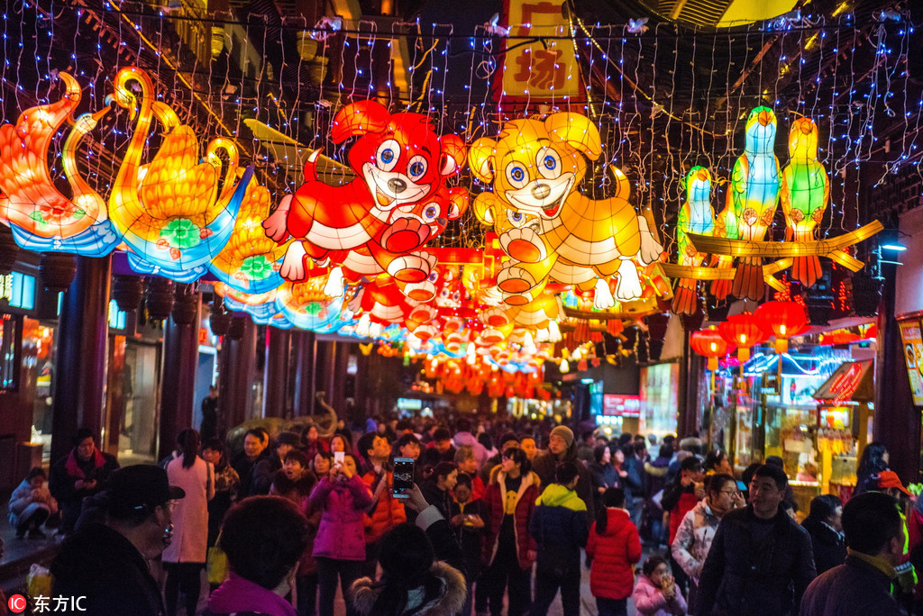
LOCAL HOLIDAYS
Lantern Festival:
15th day in 1st lunar month, usually in Feb.
Watch lanterns, eat glutinous rice dumplings, guess lantern riddles

Slide 13
FEW LANTERN RIDDLES
He devotes his life to looking after the house. His mate always follows when the master goes out. A gentleman sees him and goes away. A villain sees him and it spells bad luck. Who is he?
Which is faster, hot or cold?
It wears over 300 pieces of clothes and takes off one piece each day. At the end of the year, only one piece of cardboard is left?
A building which has most stories?

Slide 14
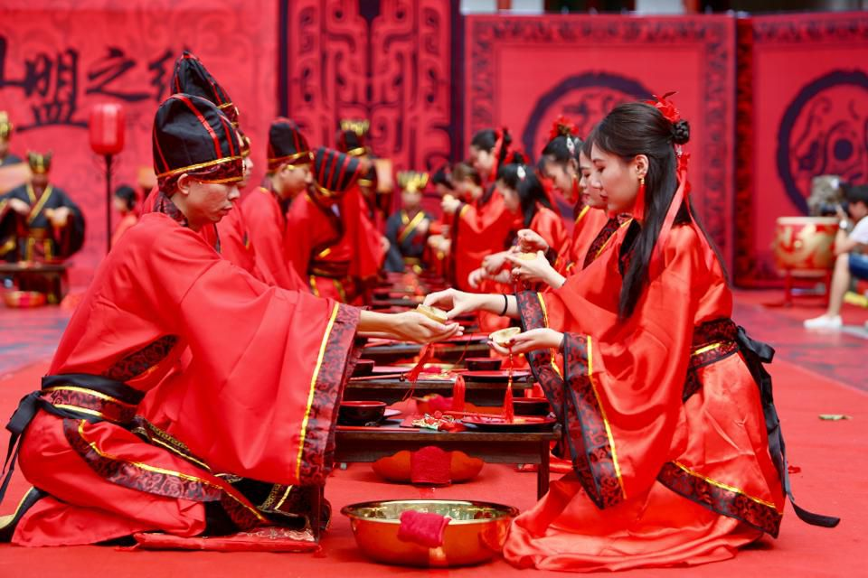
LOCAL HOLIDAYS
Double Seventh
Qixi Festival (China’s Valentine’s Day).
7th day in 7th lunar month, usually in Aug.
The festival originated from the romantic legend of two lovers, Zhinü and Niulang, who were the weaver girl and the cowherd, respectively.

Slide 15
RULES OF POLITE BEHAVIOUR
General Etiquette.
Always remember to keep calm and never to over react.
Never write in red ink.
Punctuality
Avoid public displays of affection.

Slide 16
RULES OF POLITE BEHAVIOUR
Greetings
DO’S | DONT’S
Do greet others by using a handshake or a nod | Don’t offer too firm of a handshake
Do address seniority | Don’t go straight for a hug
Do address the eldest or most senior person first. | Don’t address elders using ‘ni hao’ (use ‘Nin hao’)

Slide 17
RULES OF POLITE BEHAVIOUR
Table Manners
DO’S | DONT’S
Do join in on toasts | Don’t put bones, seeds or other in edibles into in your rice bowl
Do sample all dishes at banquets or formal occasions | Don’t tap your chopsticks
Do tap the table when someone refills your tea. | Don’t use your own chopsticks to pick food from the central dishes.

Slide 18
RULES OF POLITE BEHAVIOUR
Giving and Receiving Gifts
DO’S | DONT’S
Do Present and receive things with both hands | Don’t be too eager to unwrap your gift
Do refuse a gift a number of times before accepting it | Don’t wrap gifts using black or white wrapping paper.
Do gift small items like books, music CDs from home country | Don’t gift clocks or other symbolic items

Slide 19
RULES OF POLITE BEHAVIOUR
Etiquette in Historic and Religious Areas
DO’S | DONT’S
Do walk in a clockwise direction when touring a temple or monastery. | Don't photograph old folk without permission.
Do take off your hat when entering temples. | Don't touch a Tibetan on the head.
Do donate a few yuan to religious beggars. | Don't dip your fingers in the yak butter lamps in temples.

Slide 20


